Slide 1
SMART TRAFFIC MANAGEMENT To Create a scalable cloud and IoT-based infrastructure to monitor and manage urban traffic in real time. Propose how your system would dynamically adjust traffic signals, manage vehicle congestion, and reduce emissions by analyzing real-time data from connected vehicles and traffic cameras.
C SURYA RAJ(192221010)
SORNESH M S(192211052)

Slide 2
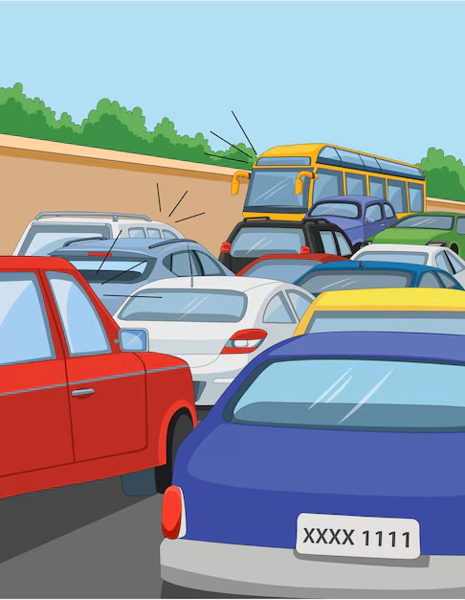
INTRODUCTION
The Scalable Cloud and IoT Infrastructure for Real-Time Smart Traffic Management system uses cloud computing and IoT sensors to monitor urban traffic and adjust signals based on real-time data.
By analyzing distance vehicles on roads, it reduces congestion and emissions, ensuring smoother traffic flow. This solution is scalable, secure, and designed to support efficient, eco-friendly urban transportation.

Slide 3
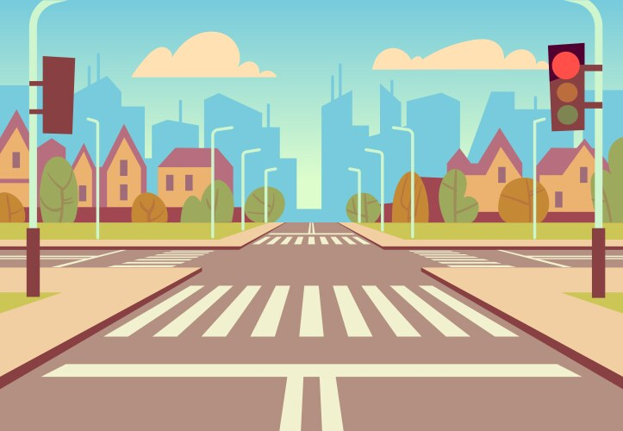
IDEA
Using ultrasonic sensor and IR sensor the amount or density of vehicles holding in particular side should be identified. And the density information will be shared to Arduino by the sensor and from Arduino the data will be shared to wifi module or wifi microprocessor.
Now wifi module will analyse the data and send the output to Arduino (ie) which light (LED light can be used)should be displayed now and for how many minutes (red,green,yellow).And the Arduino make that particular colour light glow for that period of time.

Slide 4
COMPONENTS USED
Arduino
ultrasonic sensor
LED lights
Wifi module
Connecting wires
jumper wires

Slide 5
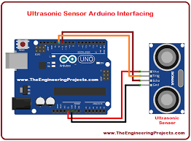
CONNECTIONS
Arduino : Acts as the central control unit, receiving data from sensors and sending control signals to traffic lights.
Ultrasonic Sensors (e.g., HC-SR04) :-
Trigger Pin (TRIG): Connects to a digital pin on the Arduino
Echo Pin (ECHO): Connects to another digital pin on the Arduino
VCC and GND: Connect to the Arduino’s 5V and GND pins.
These sensors detect vehicles by measuring distance, enabling traffic density calculations based on how close or far vehicles are from the sensor.

Slide 6
CONNECTIONS
Arduino : Acts as the central control unit, receiving data from sensors and sending control signals to traffic lights.
Traffic Light LEDs : Use three LEDs (Red, Yellow, and Green) for each traffic light signal. Connect each LED to the microcontroller’s digital pins (e.g., D4 for Red, D5 for Yellow, D6 for Green) through a current-limiting resistor.
IR Sensor :-
An infrared sensor (IR sensor) is a radiation-sensitive optoelectronic component with a spectral sensitivity in the infrared wavelength range 780 nm

Slide 7
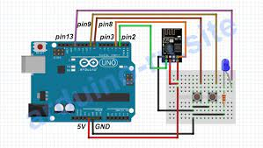
CONNECTIONS
Power Supply:-
USB Cable: Use a USB cable to power the Arduino or a portable battery if testing the model outside.
Ensure the power source can adequately support the combined current demands of the LEDs, Wi-Fi module, and sensors.

Slide 8
CLOUD PLATFROM
BLYKN: The Blynk app is a low-code IoT platform that allows users to build and manage connected hardware.
USES:
Remotely control devices: Use the app to control connected devices remotely.
Visualize data: View data from devices in the dashboard.
Receive notifications: Configure the app to send push notifications and alerts.
Monitor data: Use the app to monitor data from sensors, such as air and water quality, temperature, and humidity

Slide 9
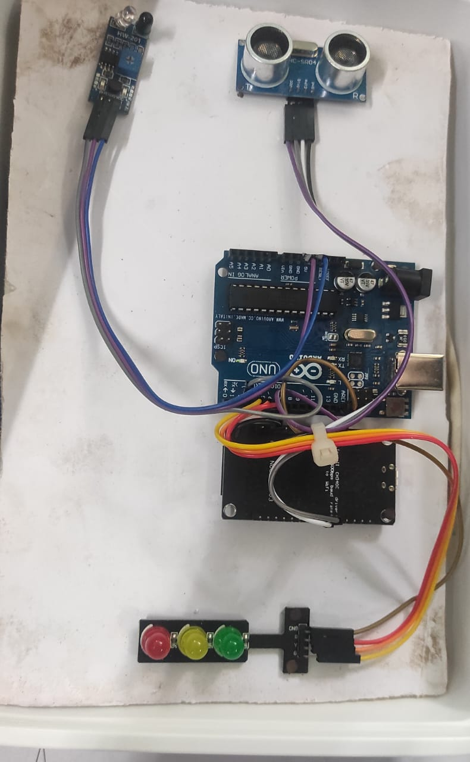
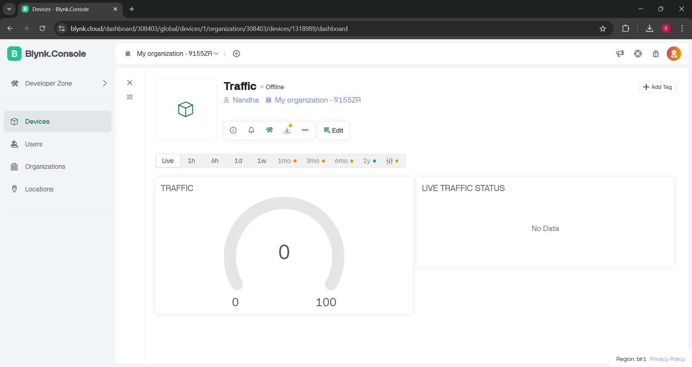
Cloud platform

Slide 10
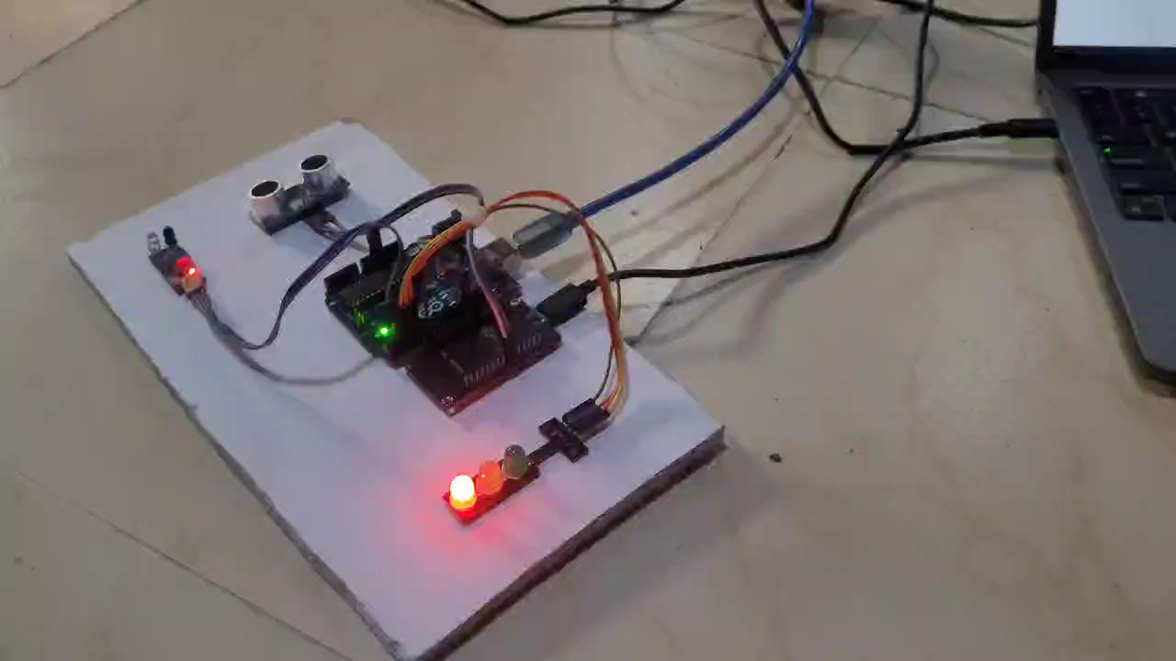
WORKING

Slide 11
THANK YOU

